Slide 1


Enterprise Intelligence Development Project
Boston Housing Prices
Regression Problem
Akshay Jadhav
November 30, 2020

Slide 2

Agenda
Objectives and Approach
Insights and trends
Predictive Modeling
Challenges/Limitations
Results on new given data
Recommendations
Future Scope

Slide 3

Objectives
A real estate agent was asked to help the Sellers in selling their houses in Boston at reasonable prices based on given details of the houses such as,
Number of rooms in the house
Poverty level in the neighboring area
Teacher to Student Ratio in the neighboring area
Based on above details project forecasts incorporates immense, valuable research,
Data analysis and visualization on past Boston Housing data to find valuable insights from raw data and given data by Sellers
Building predictive algorithms to best recommend the house prices
Justification of recommended housing prices
Other necessary factors to consider for selling the house

Slide 4
Approach
Data analysis and visualization on past Boston Housing data to find valuable insights from raw data and given data by Sellers
Statistical Descriptive Analysis
Exploring trends and patterns in the data
Relationships between various attributes of houses in the data
Building predictive algorithms to best recommend the house prices
Based on findings and results on past Boston Housing data, we would try to predict best reasonable housing prices to the sellers
Justification of recommended housing prices
Based on predicted housing prices for the given data, we would strongly justify on recommended prices
Other necessary factors to consider for selling the house
Find out other meaningful and valuable attributes/factors that need to be evaluated for more better recommendations on the house prices
Boston Housing Dataset:
https://github.com/akshayjadhav21/CS666_Project_Datasets.git

Slide 5
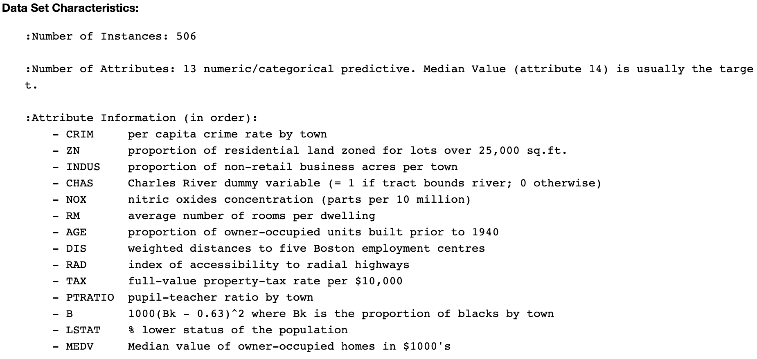
Insights & Trends
General Description

Slide 6
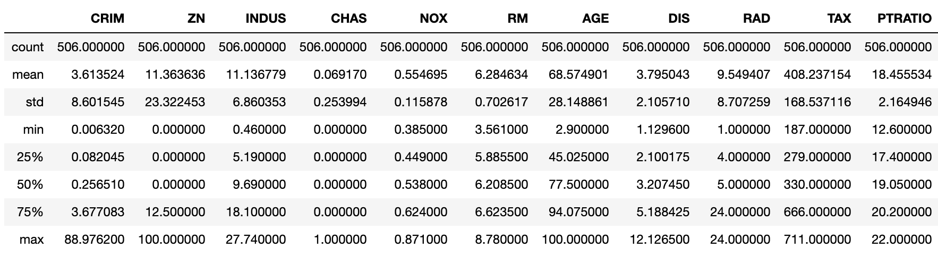
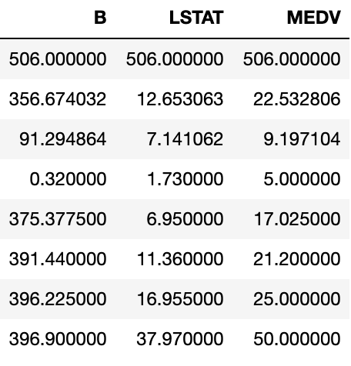
Insights & Trends
Statistical Description
House prices statistics (MEDV):
Mean: $23,000
Median: $21,000
Standard Deviation: $9,000
Minimum: $5,000
Maximum: $50,000
Findings:
The distribution of house prices in Boston seems
perfectly symmetrical.
NOTE: All MEDV values are approximate prices in thousands.

Slide 7
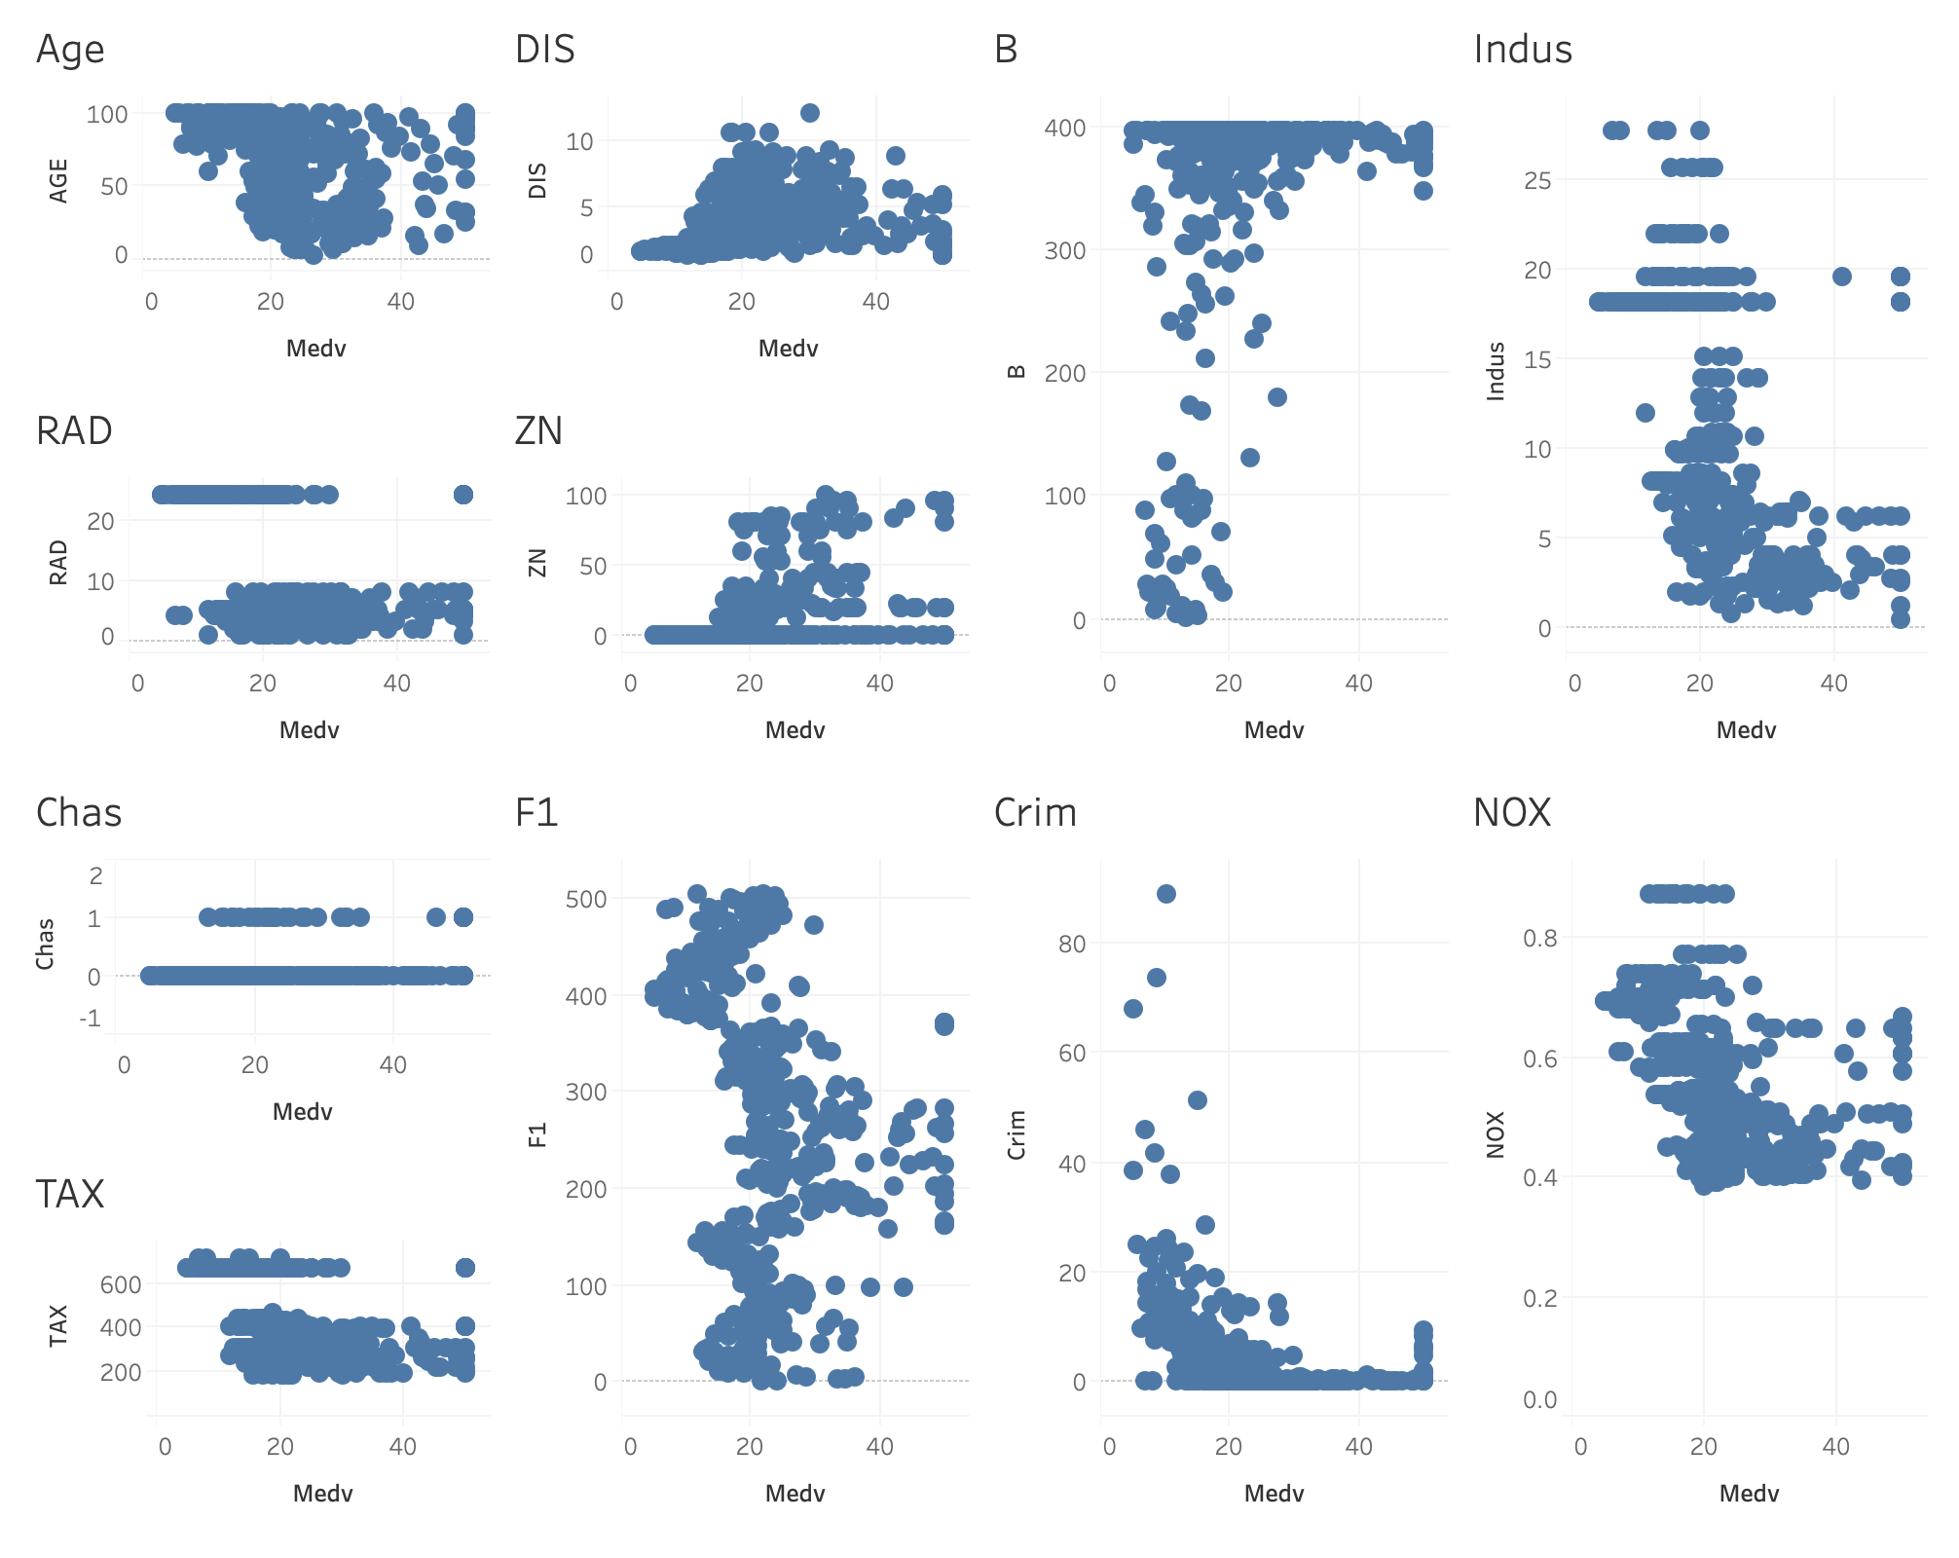
Insights & Trends
Correlation of each attribute/factor with housing price

Slide 8
Insights & Trends
Based on above correlations, the following attributes/factors are having very less contribution and very random distribution against the housing prices
Age → per capita crime rate by town
RAD → index of accessibility to radial highways
Chas → Charles River dummy variable (= 1 if tract bounds river; 0 otherwise)
TAX → full-value property-tax rate per $10,000
DIS → weighted distances to five Boston employment centres
ZN → proportion of residential land zoned for lots over 25,000 sq.ft.
B → 1000(Bk - 0.63)^2 where Bk is the proportion of blacks by town
INDUS → proportion of non-retail business acres per town
NOX → nitric oxides concentration (parts per 10 million)
Crim → per capita crime rate by town

Slide 9
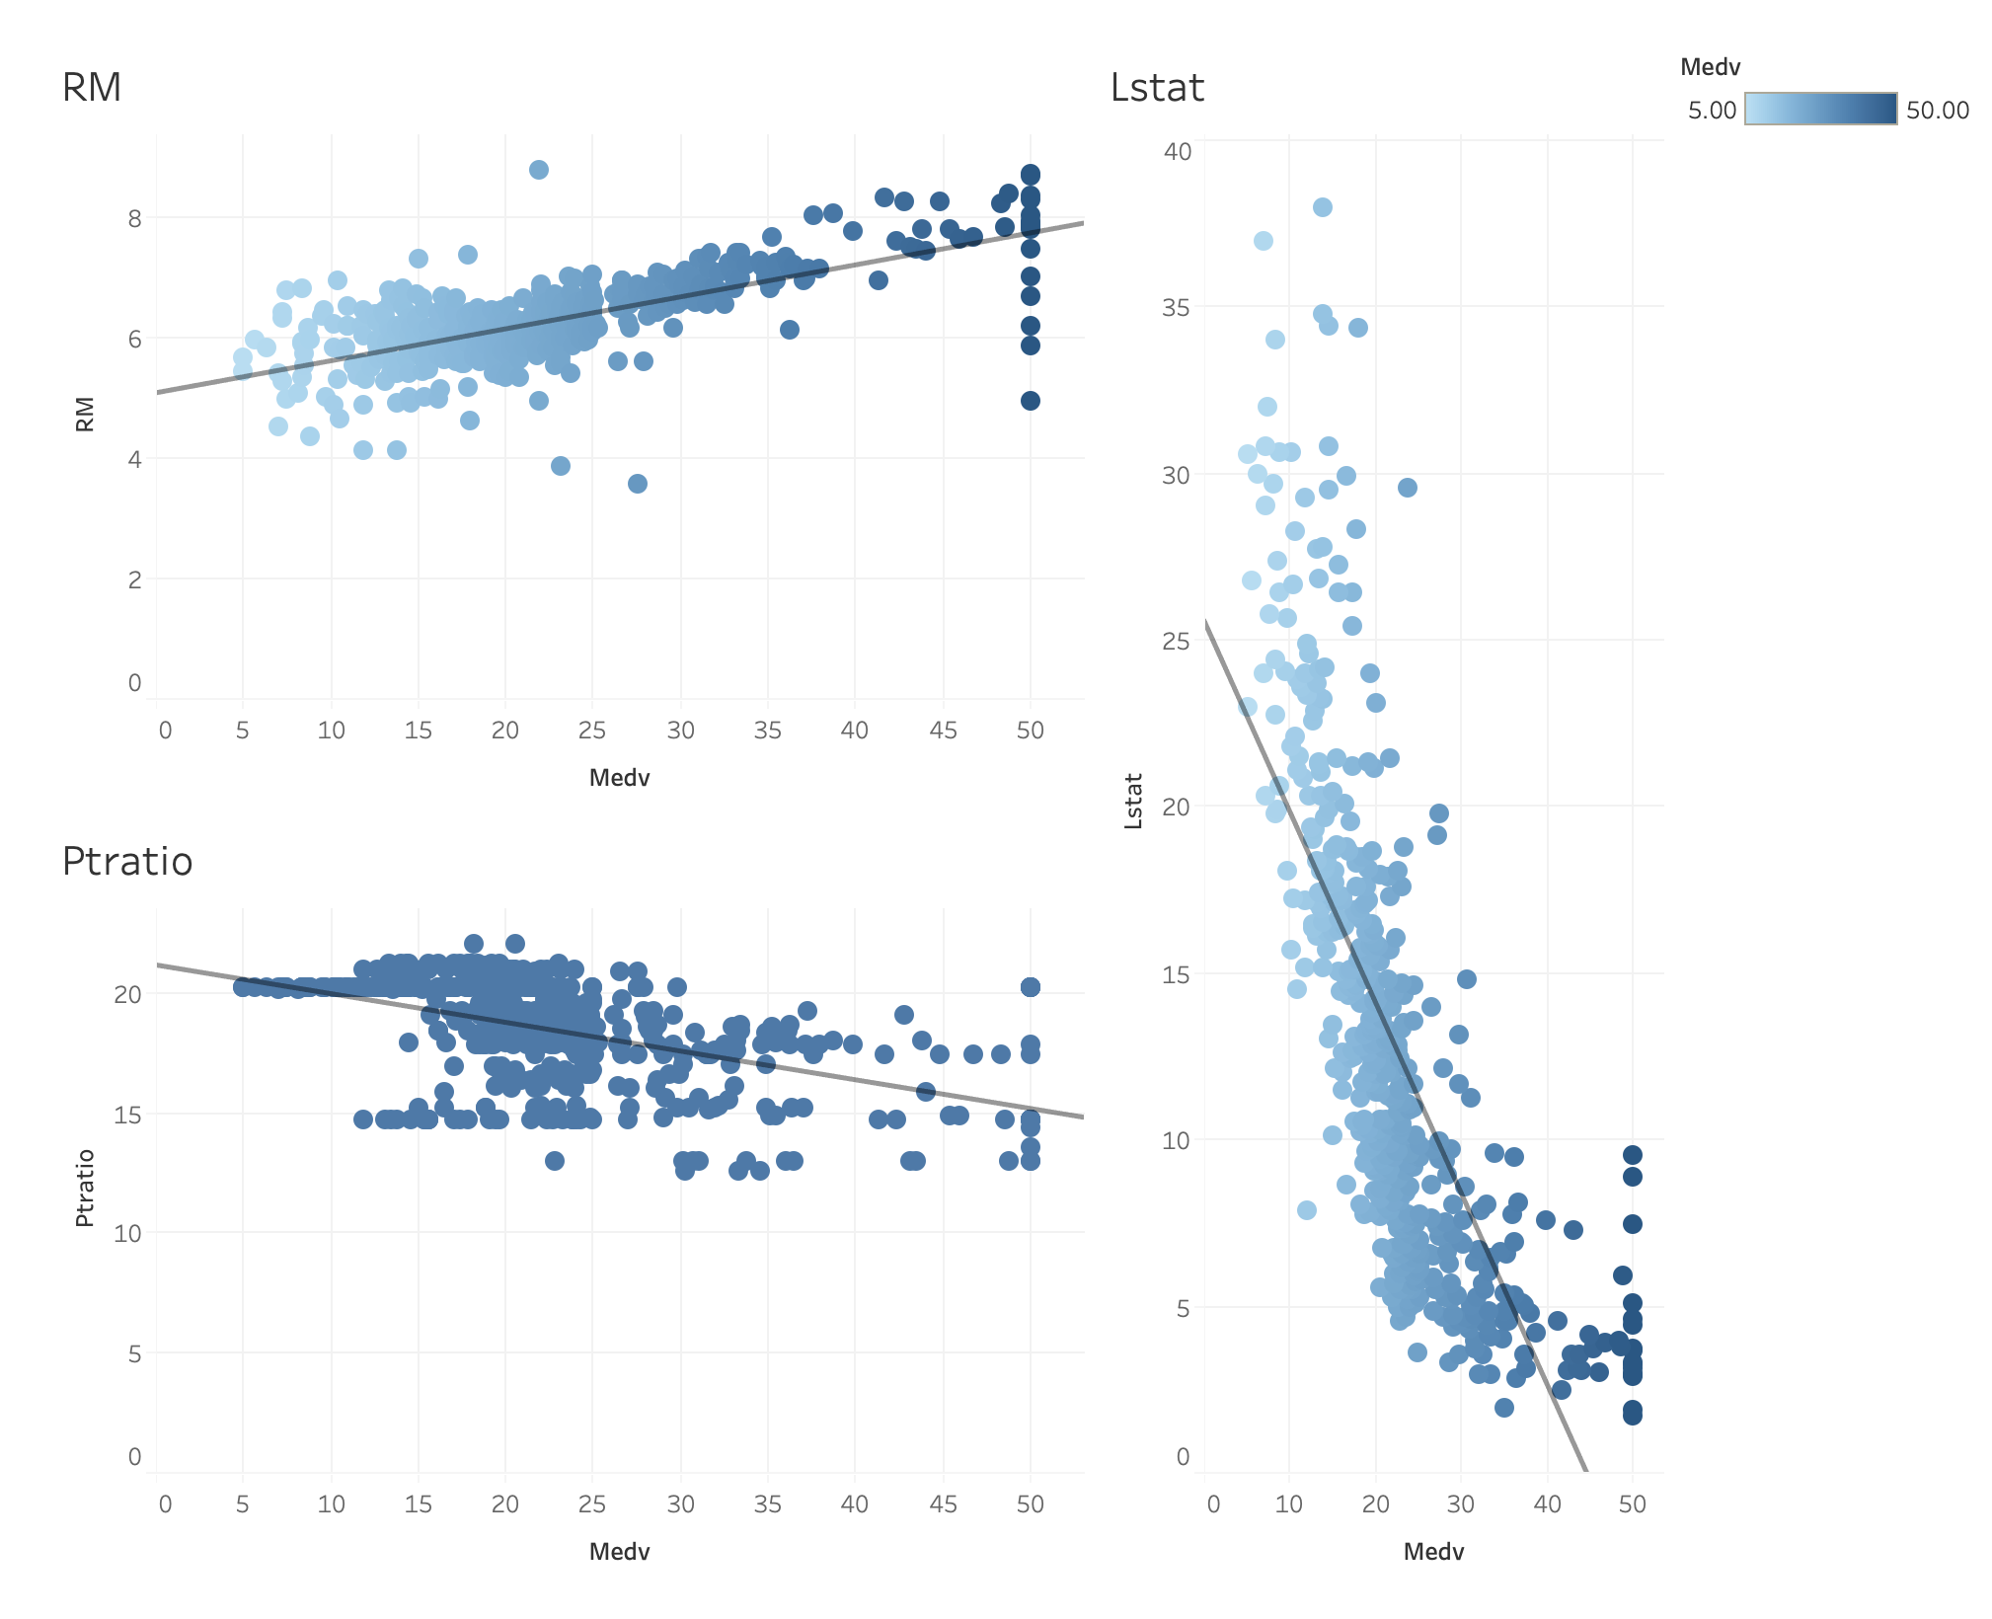
Insights & Trends
Observations:
RM (Avg. number of rooms) has positive correlation with house prices
LSTAT (Lower Status of Population) has negative correlation with house prices
PTRATIO (Teacher to Student Ratio) has slightly negative correlation with house prices
Findings:
The expected house prices would be higher for higher number of rooms.
The expected house price would be higher in the neighborhood area having few people with lower status.
The expected house price would be higher in the neighborhood area having schools with small teacher to student ratio.
Correlation of each attribute/factor with housing price

Slide 10

Insights & Trends
Based on observation and findings, the following attributes/factors are either positively or negatively correlated with house price and the most contributing factors towards towards calculating reasonable house price,
RM
LSTAT
PTRATIO
Let’s do some predictive modeling to build a system
or algorithm which will help real estate agent in finding
and recommending the best house prices
to the sellers based on given factors.
NOTE: We have performed necessary data preparation
which would be useful in increasing prediction accuracy
of the algorithm.

Slide 11
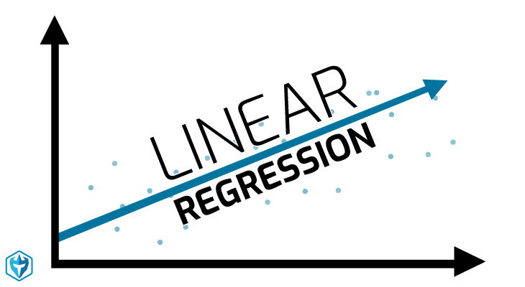
Predictive Modeling
We have built Linear Regression predictive algorithm to make the predictions on house prices based on various factors/attributes such as, number of rooms, poverty level, and teacher-to-student ratio.
Linear Regression algorithm is specifically used for regression problems such as predicting values of prices, sales based on independent factors or attributes.
We have trained the algorithm using three most contributing factors such as rooms, poverty level, and teacher-to-student ratio.
Findings:
We have achieved a good R-squared (coefficient of determination) value of 0.65 ~ 0.7
R-squared is a statistical measure which help us to know how well the house prices react to the change in values of independent factors/attributes (RM, LSTAT, PTRATIO)

Slide 12
Predictive Modeling
Ordinary Least Square Optimization Algorithm
It is optimization algorithm used to estimate the coefficients required to perform best linear regression analysis.
It is used to tune the parameters or coefficients which are important in making best fit of data points with regression line.
With best fit of a regression line around the data give us high r-squared value (coefficient of determination) which in turn gives us more reliable predictions about the housing prices.

Slide 13
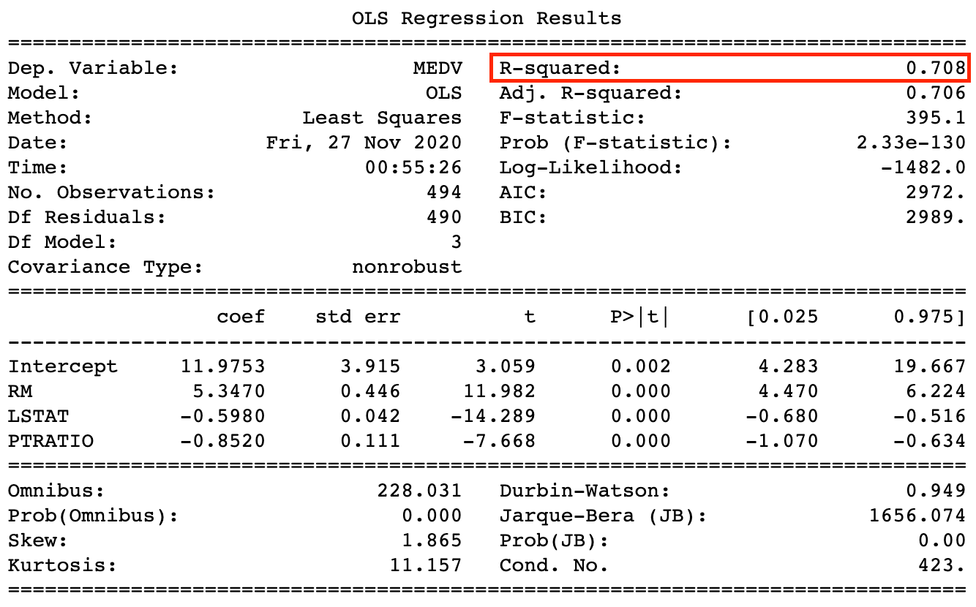
Predictive Modeling
Ordinary Least Square Optimization Algorithm Performance Metrics
Observations:
R-squared value - 0.708
Coefficients:
Intercept – 11.97
RM – 5.3470
LSTAT – (-0.5980)
PTRATIO – (-0.8520)
Findings:
Improved R-squared value gives us the confidence of algorithm or goodness of fit.
Best coefficient values for each attribute such as RM, LSTAT, and PTRATIO to get the best prediction by using them in linear regression which helps in backing up the algorithm statistically.

Slide 14
Challenges or Limitations
Removing odd values / outliers
During data analysis phase, we have got many values of input variables or factors are randomly distributed with some values are way far away from other set of values.
Such a disperse of values would have caused problems in predicting house prices if not eliminated at the right time.
We have removed the values which are out of 3rd standard deviation which generally used to detect and remove outliers, but we have found dispersed data points within 3rd standard deviation of the data distribution which are required, and we can not remove them.
Standardizing the attribute values
We have performed standardization on selected attributes which have used in predictive modeling, but we are not getting good performance metrics results using them such as high value of errors, etc.
Due to such poor and weird performance metrics, we thought that standardization of values are not required for this data and type of regression problem.

Slide 15
Results on new given data
Findings:
Seller 2 can sell house at price of $47,000
Justification: It’s reasonable house price due to a greater number of rooms (9 rooms), low rate of lower status of population (8%), lower teacher-to-student ratio in the neighborhood schools (10:1)
Seller 1 can sell house at the price of $10,000
Justification: It’s quite reasonable house price due to average number of rooms (5 rooms), average rate of lower status of population (19%), average teacher-to-student ratio in the neighborhood schools (20:1)
Seller 3 can sell house at very low price ($ -14,000)
Justification: It’s reasonable house price due to a smaller number of rooms (4 rooms), higher rate of lower status of population (37%), higher teacher-to-student ratio in the neighborhood schools (30:1)
NOTE: All house prices are approximate prices in thousands.

Slide 16



Recommendations
Based on findings of predictive analytics, a real estate agent can provide the following reasonable house prices which would be very useful for the sellers to sell their houses at good value in Boston area.
Seller 2 can sell house at price of $47,000
Seller 1 can sell house at the price of $10,000
Seller 3 can sell house at very low price ($ -14,000)
The justification are valid behind the recommended house price based on the most contributing and important attributes/factors such as rooms, lower status of population, and teacher-to-student ratio due to the following reasons,
More rooms would indicate more space in terms of Sq.ft which in turn increase the price.
In the neighborhood area having high rate of lower status people
are not safe as compared to the area dominated by higher status
people.
In schools having higher teacher-to-student ratio results in less
attention to each student that can affect their performance
in school. Such scenario are mostly with public schools and houses
around public schools are cheaper than other houses.
no
R-squared has increased from 0.65 to 0.708
Linear Regression Algorithm can be implemented as a final model.

Slide 17

Future Scope
In the intermediate years, sellers could make a confident deal with any interested buyer for the house with a recommended price without a need for online services like Zillow or many other bothering real estate agents.
To some extent, for selling the house at its best price would always be a problem for the sellers due to continuous change in the surrounding necessary factors.
We have used rooms, rate of lower status people in the neighborhood, and teacher-to-student ratio in schools to recommend the best and reasonable house prices after intensive research and analysis on Boston Housing data.
Nowadays, sellers must be more cautious and smarter about selling their homes due to many other important factors such as increasing crime rate per town, hospital services in the neighborhood, rate of public transport, urban city connectivity, logistical reach in the area, etc.

Slide 18
THANK YOU

